Slide 1
Data
Preparation
Shahriar’s Analytical Academy

Slide 2
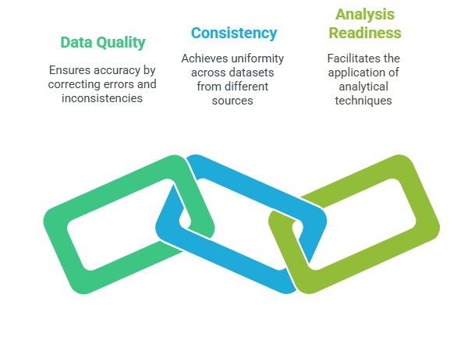
Data Preparation
Data preparation refers to the process of cleaning, transforming, and organizing raw data into a format suitable for analysis.
It involves ensuring that data is accurate, consistent, and in a usable form for analysis tools.
Notes:
Definition of Data Preparation: Data preparation is the process of transforming raw data into a clean, organized, and structured format suitable for analysis. This step involves cleaning up any inaccuracies, dealing with missing or incomplete data, and ensuring that the data is in a consistent format. Essentially, it prepares the data for further analysis so that the insights derived from it are trustworthy and meaningful.
Why Is It Necessary?
Data Quality: Raw data typically contains errors, missing values, and inconsistencies that can distort analysis results. For example, a dataset may have incorrect entries like negative values where there should be none or entries that repeat unnecessarily. If left unchecked, these issues can lead to incorrect conclusions or biased models.
Consistency: Data often comes from multiple sources, each of which may report information in different formats. For example, one source might use "MM/DD/YYYY" format for dates, while another uses "DD-MM-YYYY." Preparing the data ensures uniformity and consistency across all data sources, allowing for a smooth and accurate analysis.
Analysis Readiness: Proper data preparation makes the dataset ready for statistical analysis or machine learning models. Unclean data can produce misleading conclusions, and analytical techniques may fail to work if the data is not structured properly. For instance, if categorical data is not encoded or numerical data is not scaled, machine learning algorithms may not perform optimally.

Slide 3
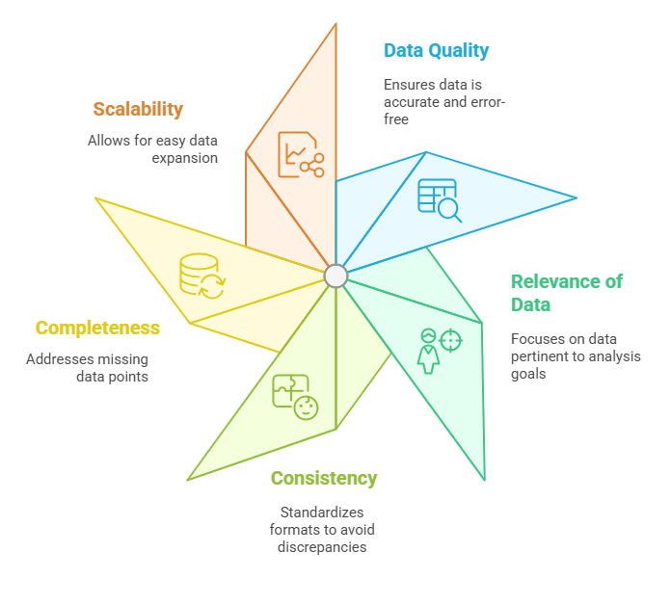
Key Factors to
Consider
Notes:
Data Quality: When preparing data, it's essential to ensure its accuracy and reliability. This involves checking for errors such as incorrect or incomplete entries, inconsistencies across different datasets, and addressing any outliers or duplicates. Cleaning the data helps eliminate these issues and ensures that the results of any analysis are reliable.
Relevance of Data: Not all data is useful for every research question or analysis. It’s essential to filter out irrelevant data that won’t contribute to the goal of the analysis. For example, if the study is about sales trends, data on employee performance might not be necessary. This step makes the dataset more manageable and focused.
Consistency: It’s vital to standardize units, formats, and naming conventions in the dataset. This could mean ensuring that all monetary values are in the same currency, dates follow the same format, and that variable names are consistent throughout. This prevents confusion and potential errors during analysis.
Completeness: Missing data is common, and it’s essential to deal with it appropriately. Depending on the dataset, this may involve deleting rows with missing values, using techniques like imputation to fill gaps, or even transforming the data to account for incomplete entries.
Scalability: As new data is added over time, it’s important to prepare the data in a format that can easily accommodate future growth. Whether it’s adding new rows or new variables, the data structure should allow for seamless updates and integrations.

Slide 4
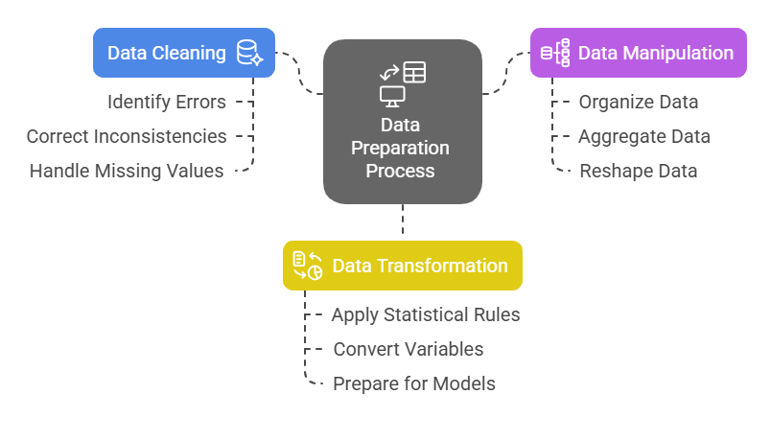
Three Steps for Data Preparation
Notes:
Data Cleaning: Data cleaning is the first crucial step in preparing data. It involves identifying and fixing errors or inconsistencies within the dataset. This could be anything from correcting misspelled entries to handling missing values. Techniques like imputation (filling in missing data with estimated values), deletion (removing incomplete entries), and interpolation (estimating values between known data points) are commonly used. The goal is to ensure the dataset is accurate and reliable, free from any anomalies that could skew results.
Data Manipulation: Once the data is cleaned, it’s often necessary to organize, reshape, or aggregate it for analysis. This might involve tasks like sorting the data, combining different datasets, or pivoting tables to group data in a more useful format. It also includes creating new variables, such as calculating the age from a birthdate or categorizing continuous data into age groups. The aim of data manipulation is to restructure the data so it aligns with the needs of the analysis, making it easier to apply statistical or machine learning methods.
Data Processing/Transformation: In this step, the data undergoes further transformation to make it ready for analytical models. This could involve scaling numerical data, encoding categorical variables into numerical values, or normalizing the data to ensure consistency. For example, transforming raw data to a standard scale (e.g., 0-1 range) is essential for many machine learning algorithms. The goal is to ensure the data is in the right format and structure to meet the assumptions of the analysis techniques being applied.

Slide 5
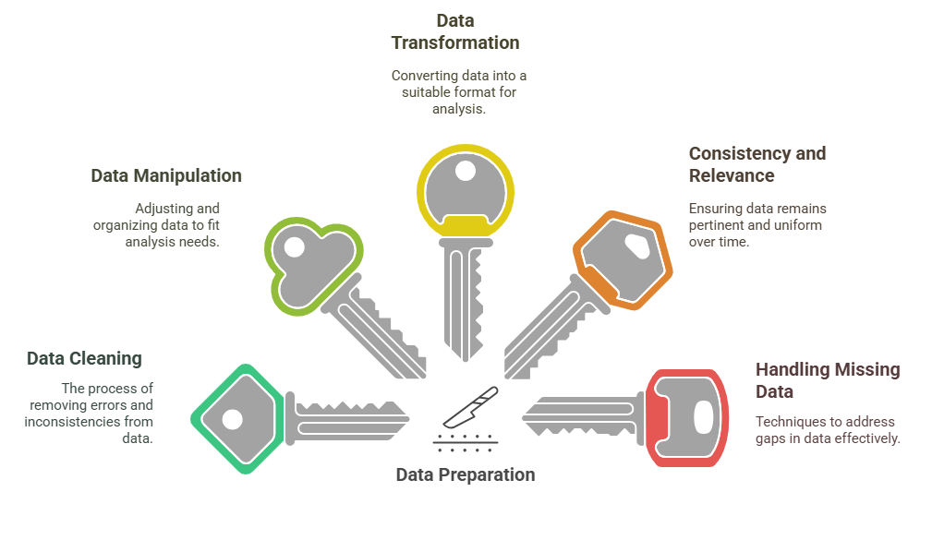
5 Key Learning Points of this Lesson
Notes:
Data Preparation is Crucial: The quality of data directly affects the accuracy of any analysis. If the data is not prepared properly, the analysis may yield incorrect or biased conclusions. Thus, preparing the data correctly is vital for ensuring the reliability and accuracy of the results.
Steps Involved in Data Preparation: Data preparation typically involves three main steps: cleaning, manipulation, and transformation. Each step addresses different aspects of data quality, structure, and readiness. These steps are essential to convert raw data into a form that is useful for analysis.
Ensuring Consistency and Relevance: Maintaining consistency across datasets and focusing on relevant data helps ensure that the analysis will provide meaningful and accurate results. By filtering out irrelevant data and standardizing formats, we reduce the risk of errors during analysis.
Techniques for Handling Missing Data: Missing data can skew results, but there are various techniques to deal with it, such as imputation, deletion, or interpolation. Understanding when and how to use these methods is crucial for maintaining the integrity of the dataset.
Impact of Well-Prepared Data: Proper data preparation lays the foundation for effective analysis. It ensures that the data is clean, relevant, and consistent, leading to more accurate, reliable, and actionable insights. Well-prepared data ultimately drives better decision-making in any analytical process.

Slide 6
Thank You!
Shahriar’s Analytical Academy

